Slide 1
Child Food Poverty in Pendle

Slide 2
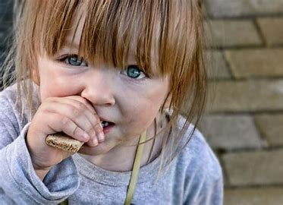
What is Child Food Poverty?
UNICEF says “children’s inability to access and consume a nutritious and diverse diet in early childhood.”
This means: children who don’t get enough proper, healthy food that would help them to grow healthier and stronger.

Slide 3
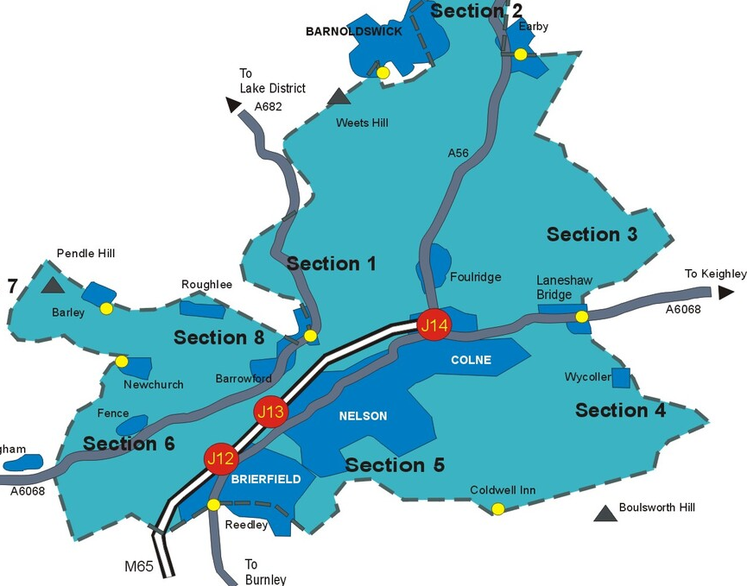
Did you know….?
Children’s food poverty is higher in Pendle than anywhere else in the country.
This means that where we live lots of children go without enough healthy food…..

Slide 4
A whopping 43.6% of children in Pendle are affected by food poverty …. almost a half.
We need to help do something about this! NOW!

Slide 5
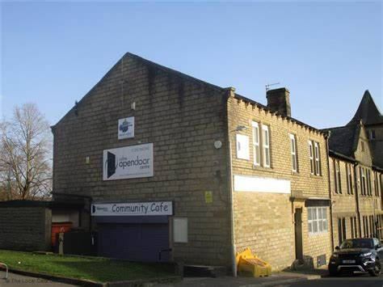
Colne Open Door
We are working with Colne Open Door to help raise money and food donations for children in need in our area.

Slide 6
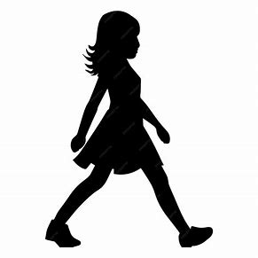
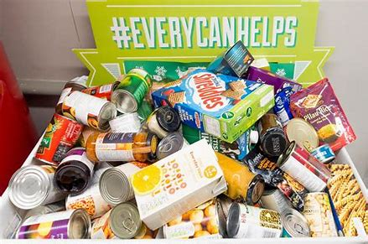
Our first step…
Food donations before Friday 14th February
These foods must be tinned or dried so that they don’t perish (don’t go off), for example:
Tinned food such as: fruit, beans, soup, peas, sausages…
Dried food such as: breakfast cereals, rice, pasta, noodles…
Tea bags, coffee, hot chocolate, sugar, long life milk and fruit juice…

